Slide 1
W. D. Snodgrass, “Leaving the Motel”
Introduction to English Literature 04
May 14, 2025

Slide 2
What is Tone?
Tone, a term borrowed from acoustics and music, refers to the qualities of the language a speaker uses in social situations or in a poem, and it also refers to a speaker’s intended effect. Tone is closely related to style and diction; it is an effect of the speaker’s expressions, as if showing a real person’s feelings, manner, and attitude or relationship to a listener and to the particular subject or situation. Thus, the speaker may use angry or mocking words, may address the listener intimately or distantly, may sincerely confess or coolly observe, may paint a grand picture or narrate a legend(462).

Slide 3
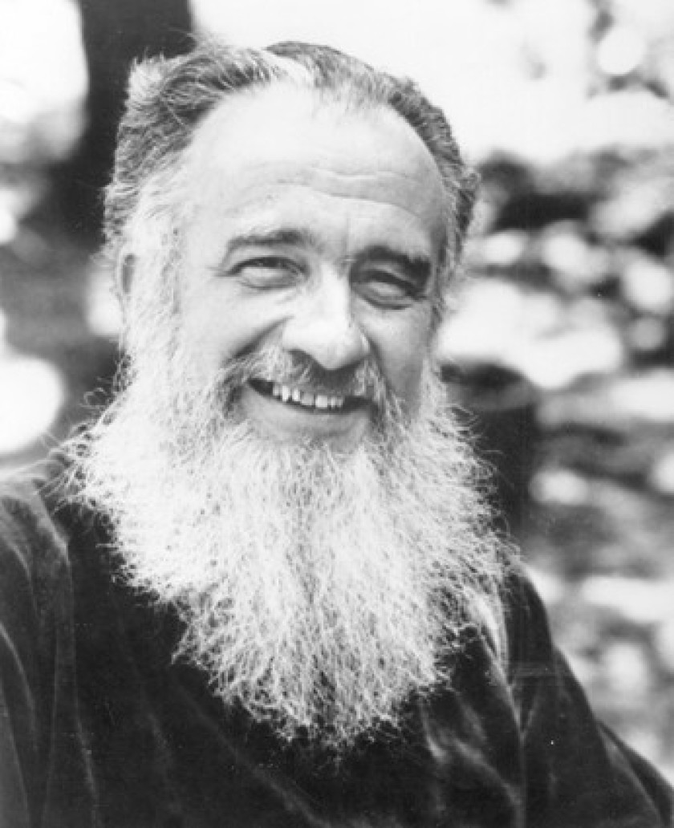
W. D. Snodgrass
One of the founders of the Confessional movement in poetry.
Confessional poets present intimate, and sometimes unflattering, information and details about their personal lives.
of a very personal nature.
careful attention to poetic form.

Slide 4
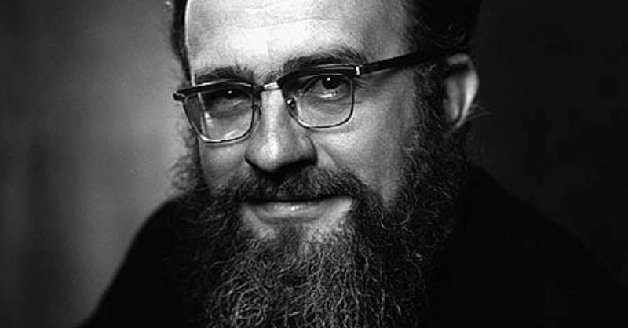
W. D. Snodgrass
Born in Wilkinsburg, Pennsylvania, on 5 January 1926 as a son of an accountant.
The Iowa Writers' Workshop at the University of Iowa, where he studied with such brilliant and illustrious poets as Robert Lowell , Randall Jarrell and Berryman.
A distinguished teaching career at several universities beginning with an English instructor at Cornell college(1955-57).

Slide 5
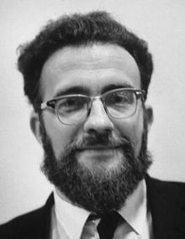
W. D. Snodgrass
Won the 1960 Pulitzer Prize for Poetry.
Thomas Lask, a critics, says, “His poetry was appealing in that the poet stood in front of the work -- there was no need to hunt for the man in the lines. He spoke for and about himself.”
Reintroduced “confessional writing style” to the poetic community at a time when many poets were taking a more modern approach to poetry based on anti-expressionistic principles.
Recognised as one of leading American poets of his generation.

Slide 6
Leaving the Motel I
Outside, the last kids holler
Near the pool: they’ll stay the night. Pick up the towels; fold your collar
Out of sight.
Check: is the second bed
Unrumpled, as agreed?
Landlords have to think ahead
In case of need,
바깥에는 끝까지 남은 애들이 고함치고 있어.
수영장 옆에서. 그들은 오늘까지 자고 갈 거야.
수건을 집어들어 그리고 (밖으로 나온) 셔츠의 깃을 안보이게 접어 넣어.
점검해. 두번째 침대는 합의한대로 구겨진 데가 없는지?
주인들은 만약의 경우에 대비해 미리 생각하기도 해야 되거든.

Slide 7
Leaving the Motel II
Too. Keep things straight: don’t take
The matches, the wrong keyrings—
We’ve nowhere we could keep a keepsake—
Ashtrays, combs, things
That sooner or later others
Would accidentally find.
Check: take nothing of one another’s
And leave behind
물건들을 똑바로 정리할 것. 가져가면 안돼
성냥이나 다른 사람의 열쇠고리같은 것.
우리는 정표같은 것을 둘 데가 없거든.
재떨이도, 빗같이
조만간 다른 사람들이 우연히 발견될 물건들 말이야.
점검해. 상대방의 물건은 가져가지 말고, 남겨둘 것은

Slide 8
Leaving the Motel III
Your license number only,
Which they won’t care to trace;
We’ve paid. Still, should such things get lonely,
Leave in their vase
An aspirin to preserve
Our lilacs, the wayside flowers
We’ve gathered and must leave to serve
A few more hours;
당신의 자동차면허번호 뿐. 그들이 굳이 그것까지 추적하진 않을테니.
돈은 다 냈어. 하지만, 그런 물건들도 외로워질지도 모르니, 여기 있는 꽃병에 아스피린을 한 알 넣읍시다.
우리의 라일락 꽃이 시들지 않게.
우리가 길가에서 꺾었지만,
남겨놓아야 하는 꽃들이
지지 않게
몇 시간만이라도 더.

Slide 9
Leaving the Motel IV
That’s all. We can’t tell when
We’ll come back, can’t press claims,
We would no doubt have other rooms then, Or other names.
그게 다야. 우리는 알 수 없어.
우리가 언제 돌아올지, (다시 오자고) 요구할 수도 없어.
틀림없이 그때는 다른 방들을 얻거나 아니면 다른 이름들로 (방을) 얻을테니.

Slide 10
An analysis from the Text
The title and details of "Leaving the Motel" indicate the situation and setting: Two secret lovers are at the end of an afternoon sexual encounter in a motel room (perhaps one is speaking for both of them), reminding themselves not to leave or take with them any clues for “others” (line 13)—their spouses?—to find. Whereas many poems on the topic of love confirm an enduring attachment or express desire or suggest erotic experience, this poem focuses on the effort to erase a stolen encounter. The two lovers have no names; indeed, they have registered under false names. They have already paid for this temporary shelter, can’t stay the night like other guests or build a home with children of their own, and are running through a checklist of their agreements and duties (“Check,” “Keep things straight,” “Check” [lines 5, 9, 15]). Other than the “wayside” lilacs (line 22), the objects mentioned are trivial, from matches and keyrings to license numbers. The matter-of-fact but hurried tone suggests that they wish to hide any deep feelings (hinted at in the last two stanzas in the wish to make “claims” or preserve flowers [line 26]). The failure to express love—or guilt—enhances the effect when the tone shifts, at the word “still” (line 19), to the second thoughts about leaving something behind. The poem’s short rhyming lines, sounding brisk and somewhat impersonal, contrast with the situation and add to the tone of subdued regret that nothing lasts(463-64/795-96).

